Slide 1
How to Enter Initial Awards
1. Log in using your NetID
https://yale.communityforce.com

Slide 2
2. Enter NetID and password
3. CAS log in
Entering Initial Awards Tutorial

Slide 3
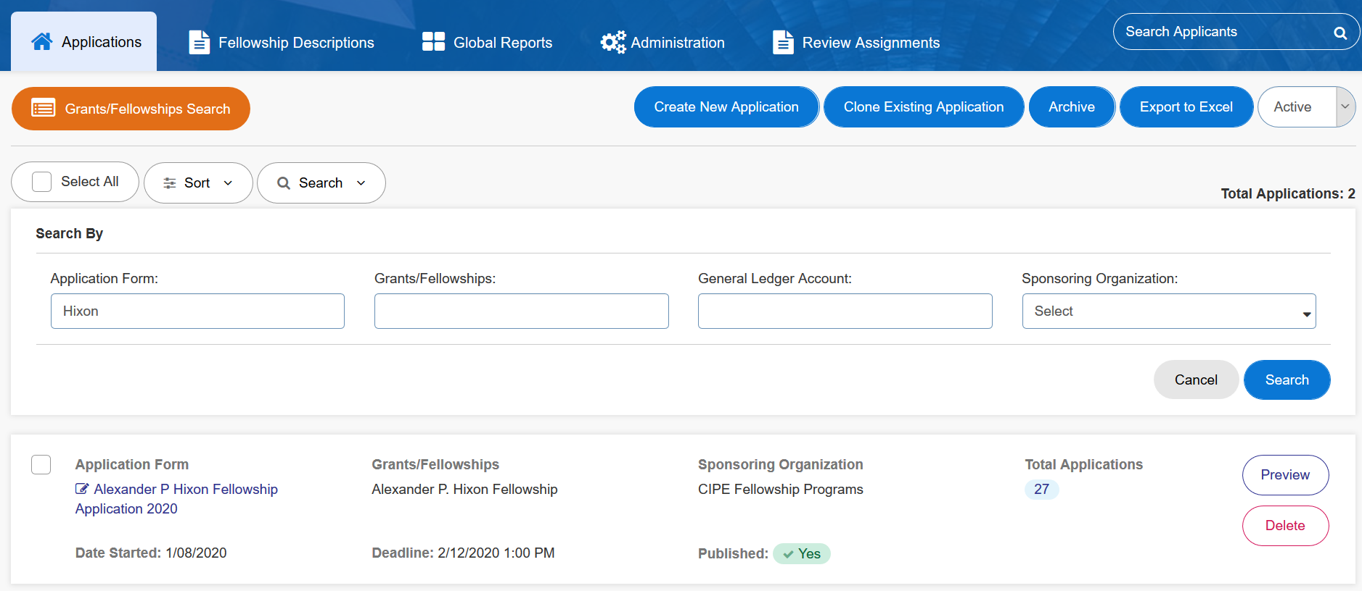
4. In the “Applications” tab, choose the appropriate application form
Entering Initial Awards Tutorial

Slide 4
5. Select “Awards” from the top menu
Entering Initial Awards Tutorial

Slide 5
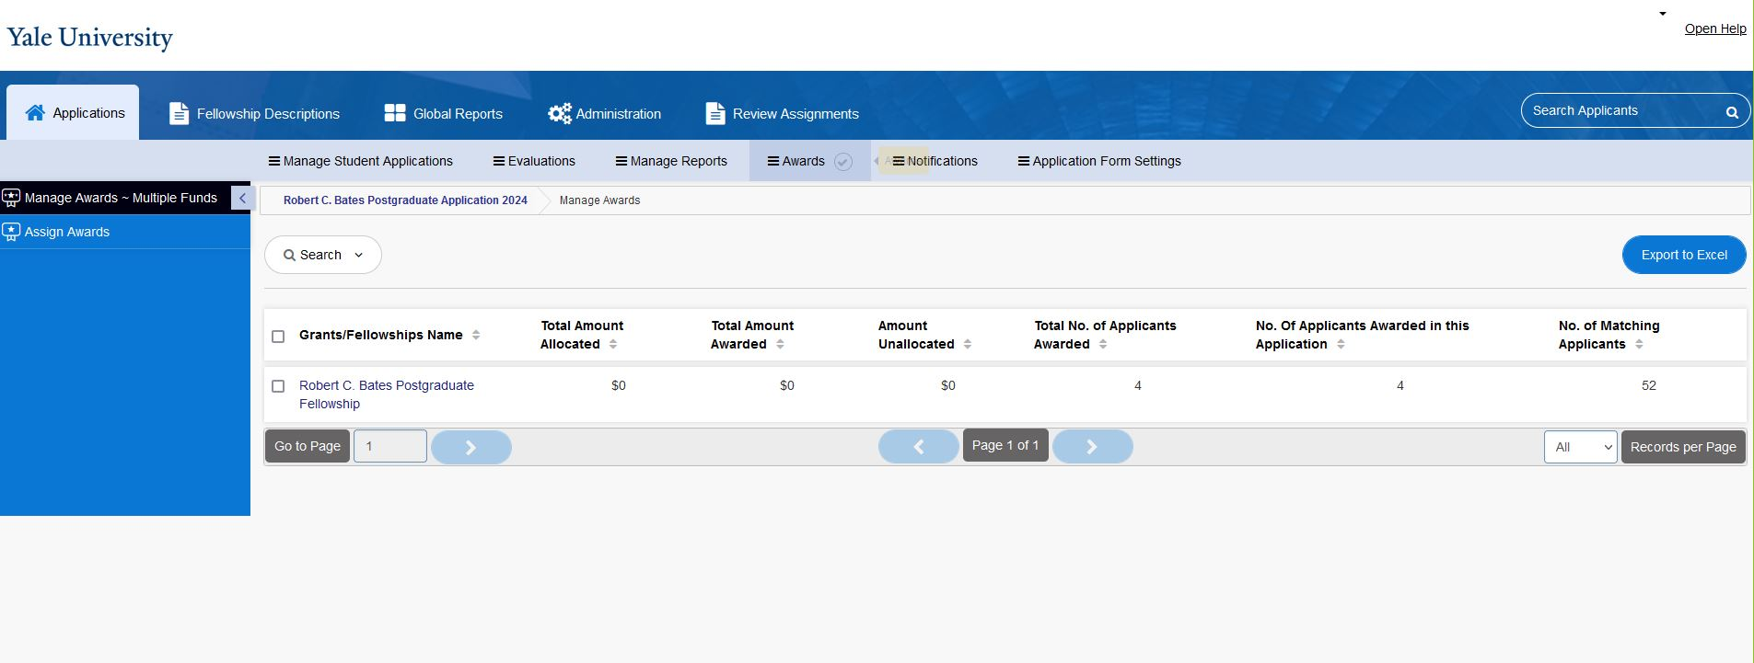
6. Select “Assign Awards” from the side menu
Entering Initial Awards Tutorial

Slide 6
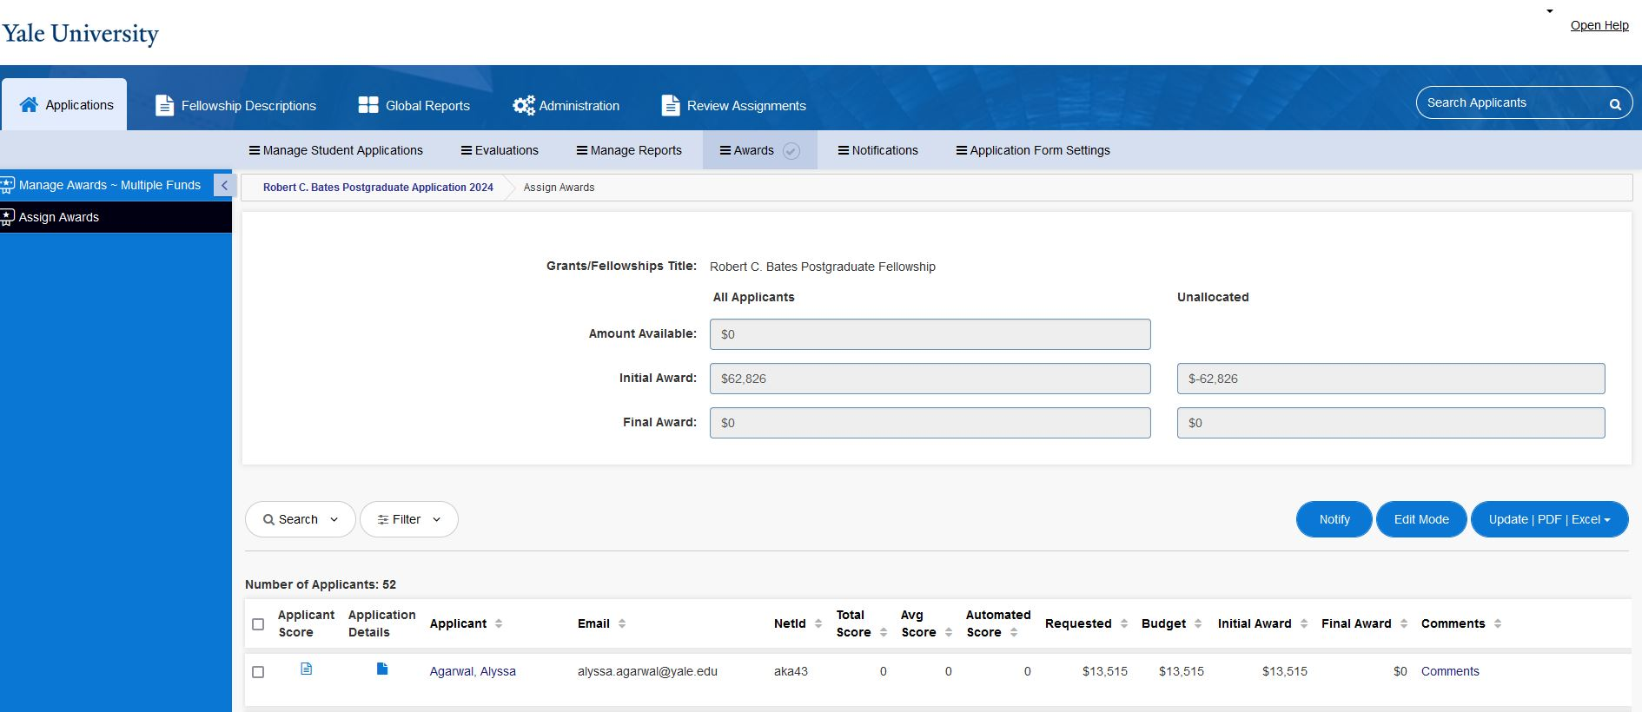
7. Click on “Edit Mode”
Entering Initial Awards Tutorial

Slide 7
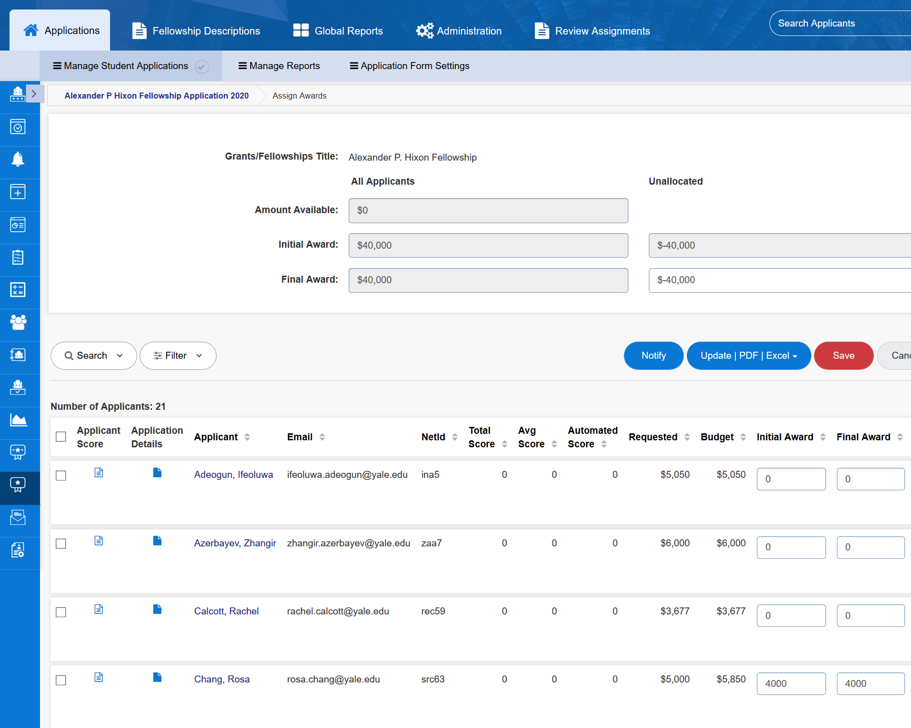
10. Click “save”
8. Check the box next to the applicant’s name
NOTE: Entering a value in the “Final Award” column will automatically change the applicant status to “Selected for Award”. The applicant will be able to see this on their dashboard but will not be automatically notified of the award.
9. Enter the award amount in the “Initial Awards” (before Overlap) or “Final Awards” (after Overlap) column
Entering Initial Awards Tutorial

Slide 8
Questions? Please contact the Yale Student Grants team with any questions: studentgrants@yale.edu.

